Slide 1
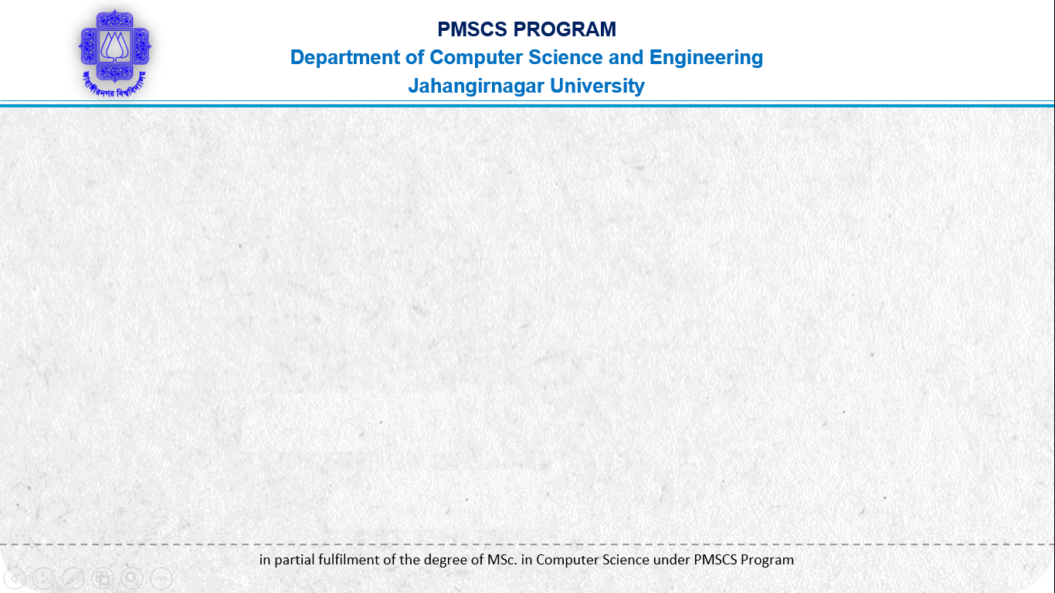
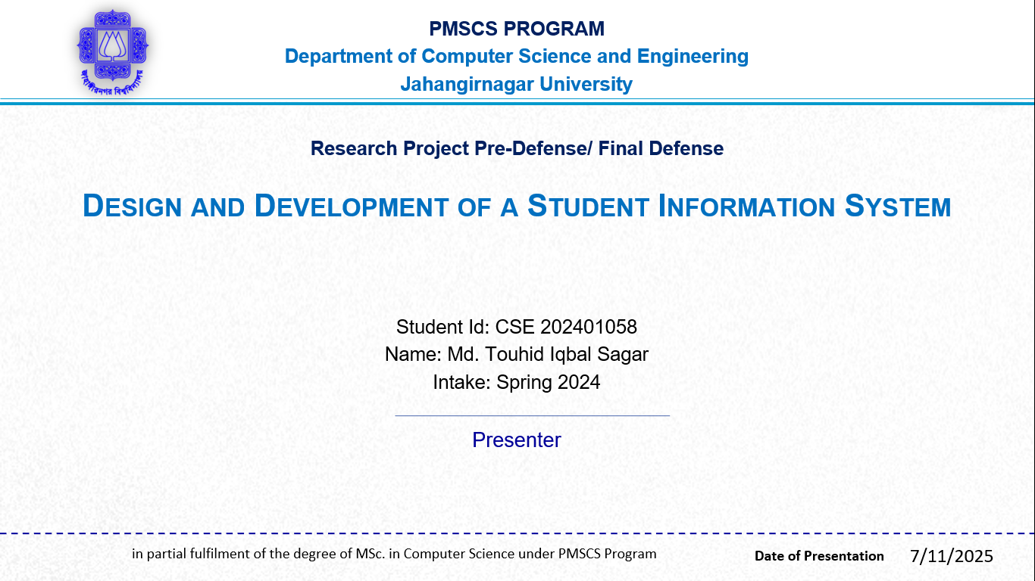
Project Defense
Design and Development of a Student Information System
Student Id: CSE 202401058
Name: Md. Touhid Iqbal Sagar
Intake: Spring 2024
Presenter
12-07-2025
7/12/2025

Slide 2

Content
Deployment & Hosting
Demonstration
Results & Findings
Future Enhancements
Conclusion
References
Q&A / Thank You
Introduction
Problem Statement
Proposed Solution
System Requirements
System Design
User Interface & Features
Implementation
Testing & Debugging

Slide 3

Introduction
Background of the Problem
Manual Record-Keeping Issues
Limited Accessibility & Efficiency
Security & Data Integrity Concerns
Scalability & Management Issues
Motivation for the Project
Need for Centralized Student Data
Improved Accuracy & Reduced Errors
Faster Access to Information
Enhancing Communication & Transparency
Project Scope & Objectives
Centralized Data Management
Automation & Efficiency
User-Friendly Interface
Real-time Access
Security & Privacy
Scalability & Integration

Slide 4

Problem Statement
Problem Definition
Manual or outdated systems.
Disorganized records.
Time-consuming tasks and miscommunication.
Significance of the Problem
Ensures smooth operations.
Manual handling leads to difficulty.
Improves communication, accuracy, and saves time.
Tracking student data.
Gap Filled by the Student Information System
Centralized Platform.
Task Automation.
Efficiency Boost.
Improved Communication.
Real-Time Access.

Slide 5
Proposed Solution
Description of the software
Student Registration.
Course Management.
Department Management.
Grading System.
Reports & Analytics.
User Roles & Authentication.
Benefits and advantages
Improved efficiency.
Better communication.
Real-time access.
Reduces errors and duplication.
Target Users
Students.
Teachers.
Administrators.

Slide 6
System Requirements (Hardware)
Server (if self-hosted)
Processor: Intel i3/i5 or AMD Ryzen 5/7 (or higher)
RAM: 8GB (minimum), 16GB+ (recommended)
Storage: SSD (256GB+ for fast access)
Client Machines (for users)
Processor: Intel i3/i5 or AMD equivalent
RAM: 4GB (minimum), 8GB+ (recommended)
Storage: 128GB+Display: 1366x768 resolution (minimum)
Other Peripherals
Printer (for reports)

Slide 7
System Requirements (Software & Technology)
Operating System: Windows 10/11, macOS, or Linux (Ubuntu recommended for servers).
Database Management System: MySQL / SQL Server.
Web server: XAMP.
Code editor: Visual Studio Code.
XAMP (PHP development).
Git (Version control).
Programming language: PHP
Backend Development: PHP.
Frontend Development: HTML, CSS.
Frameworks & Libraries: Laravel (PHP), Bootstrap (CSS).
Database: MySQL, SQL Server.
Version control: Git, GitHub

Slide 8
System Design (System Architecture Diagram)
Admin
Student
Manage all data
Information
Student Information System
Academic History
Details
Courses
Details
Departments
Figure: System Architecture of Student Information System

Slide 9
System Design (Entity-Relationship Diagram)
Student List
New Student add
User Name
Department list
Settings
Password
Admin
Controls
Dash Board
Course List
User List
Academic history
Student
View
Course
Course code
Roll
Name
Status
Status
Address
Department
Name
Date of Birth
Status
Name
Figure: Entity- Relationship Diagram of Student Information System

Slide 10

System Design (Use Case Diagram)
System Boundary
Username & Password
Student List
New Student add
<<include>>
Dashboard
Department List
Log in
Admin
User List
Course List
Figure: Use Case Diagram of Student Information System

Slide 11
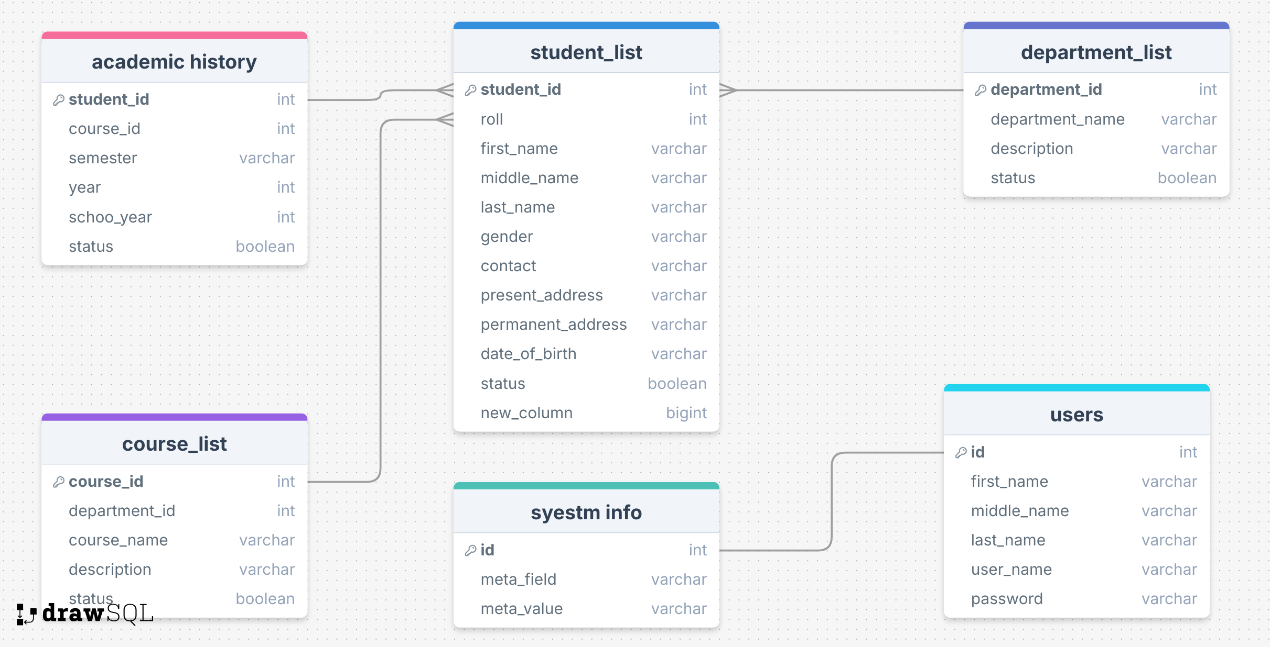
System Design (Database Schema Overview)
Figure: Database Schema Overview of Student Information System

Slide 12
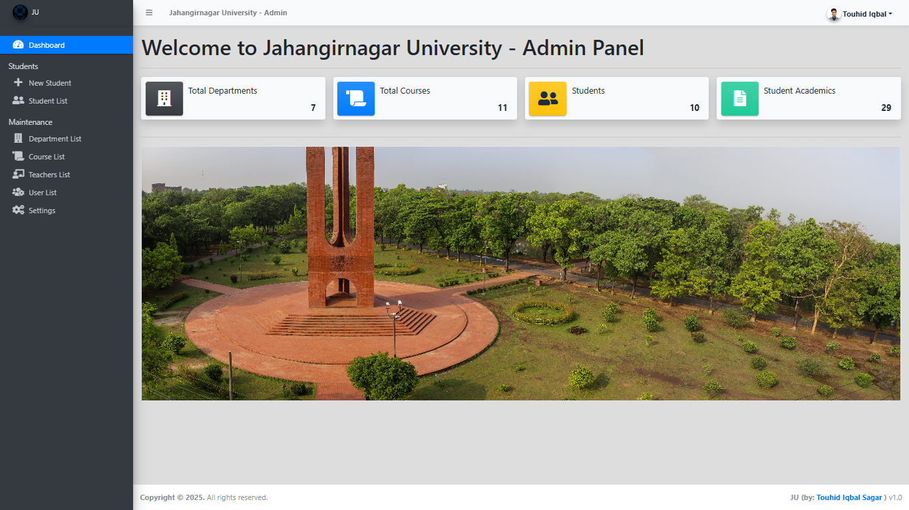
User Interface & Features
Figure: Dashboard of Student Information System

Slide 13
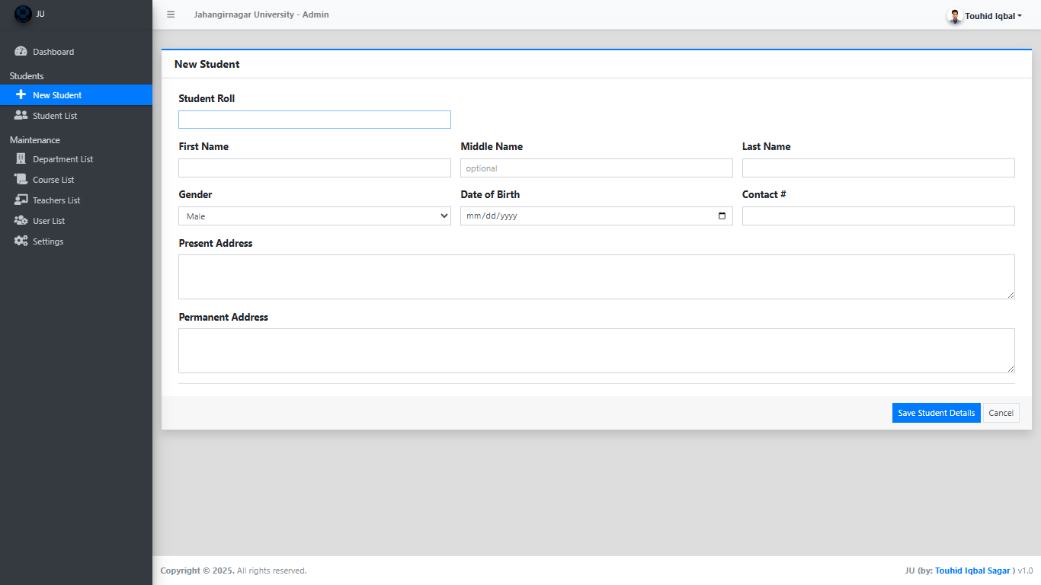
User Interface & Features
Figure: New student add page of Student Information System

Slide 14
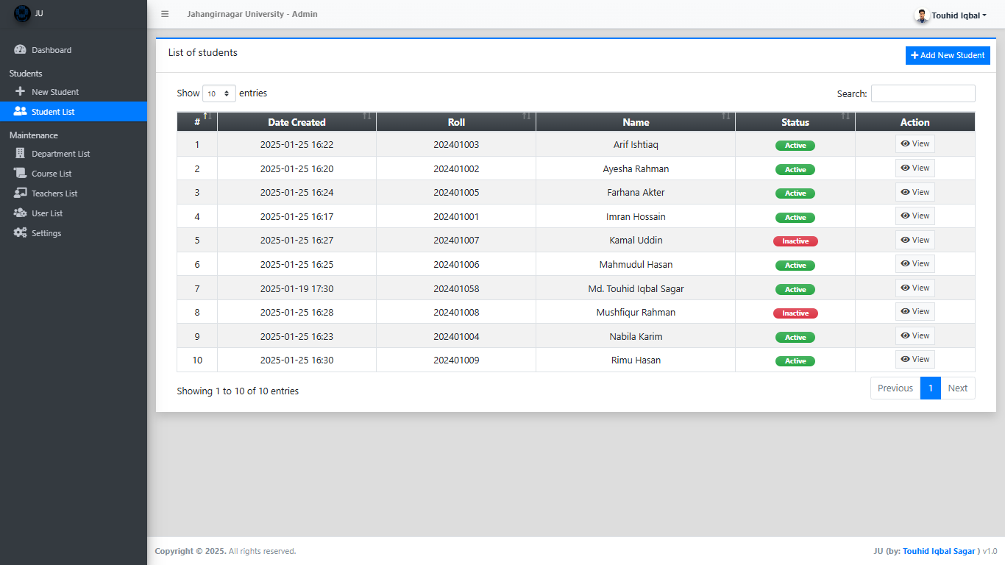
User Interface & Features
Figure: Student list page of Student Information System

Slide 15
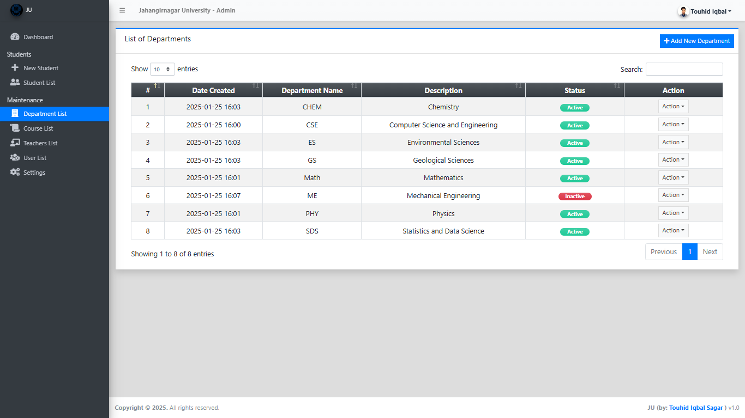
User Interface & Features
Figure: Department list page of Student Information System

Slide 16
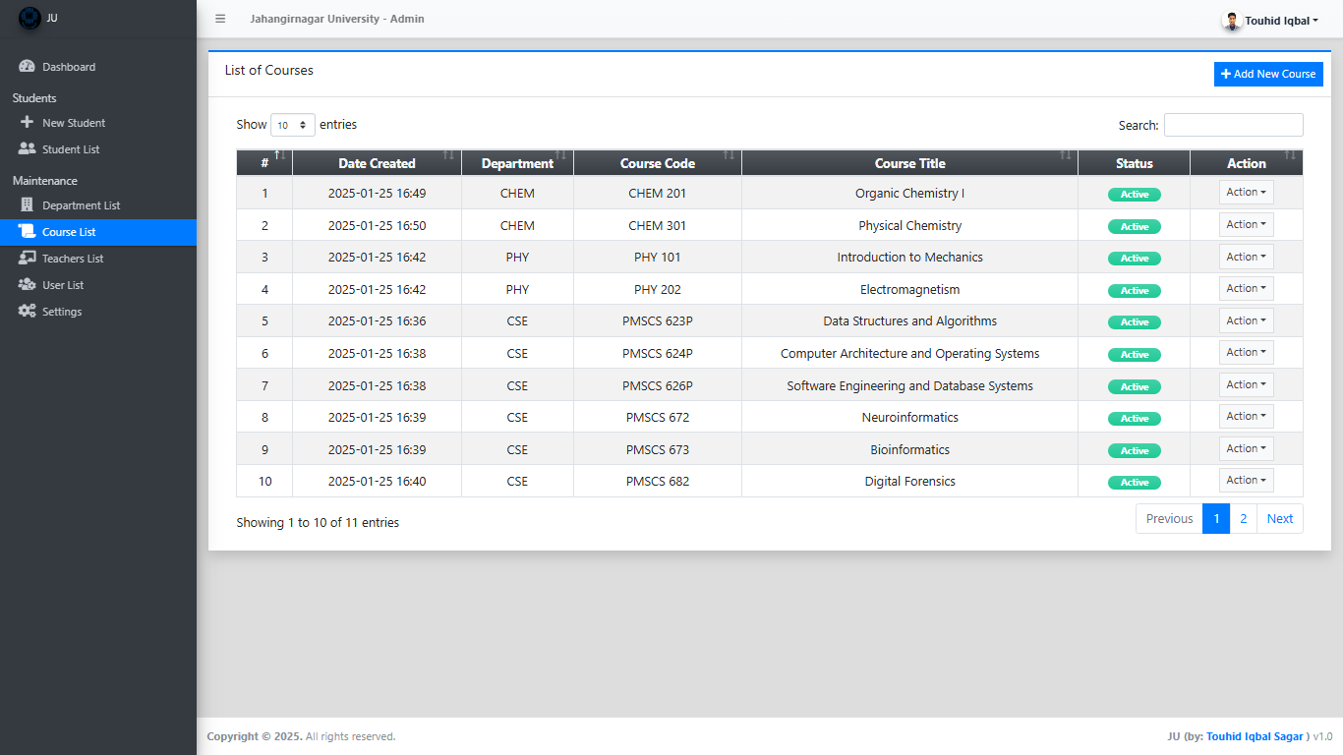
User Interface & Features
Figure: Course list page of Student Information System

Slide 17
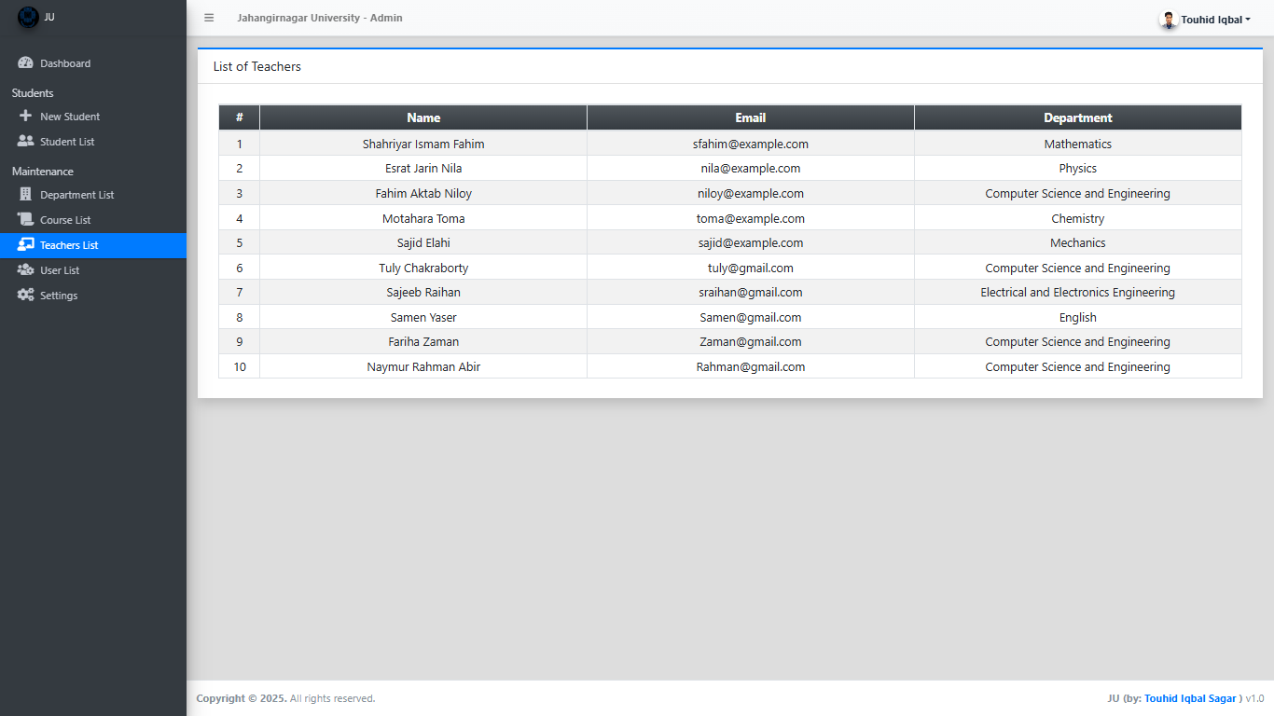
User Interface & Features
Figure: Teachers list page of Student Information System

Slide 18
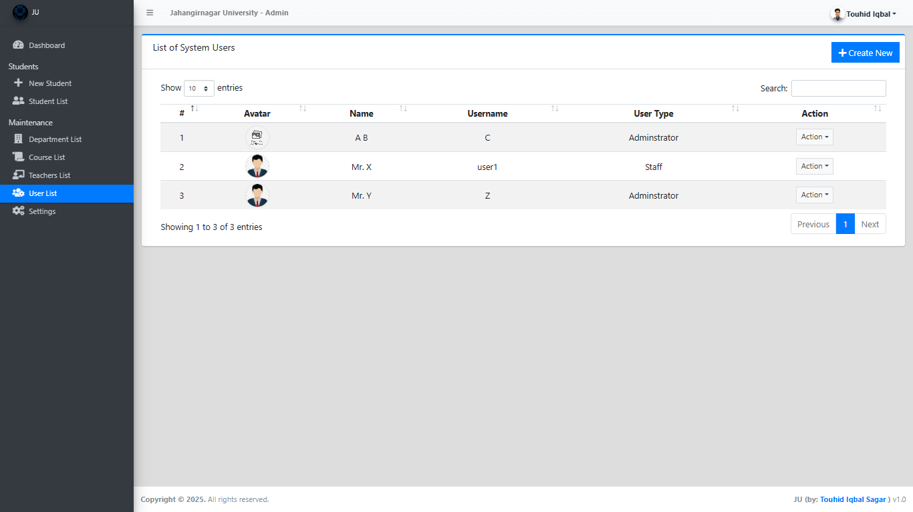
User Interface & Features
Figure: User list page of Student Information System

Slide 19
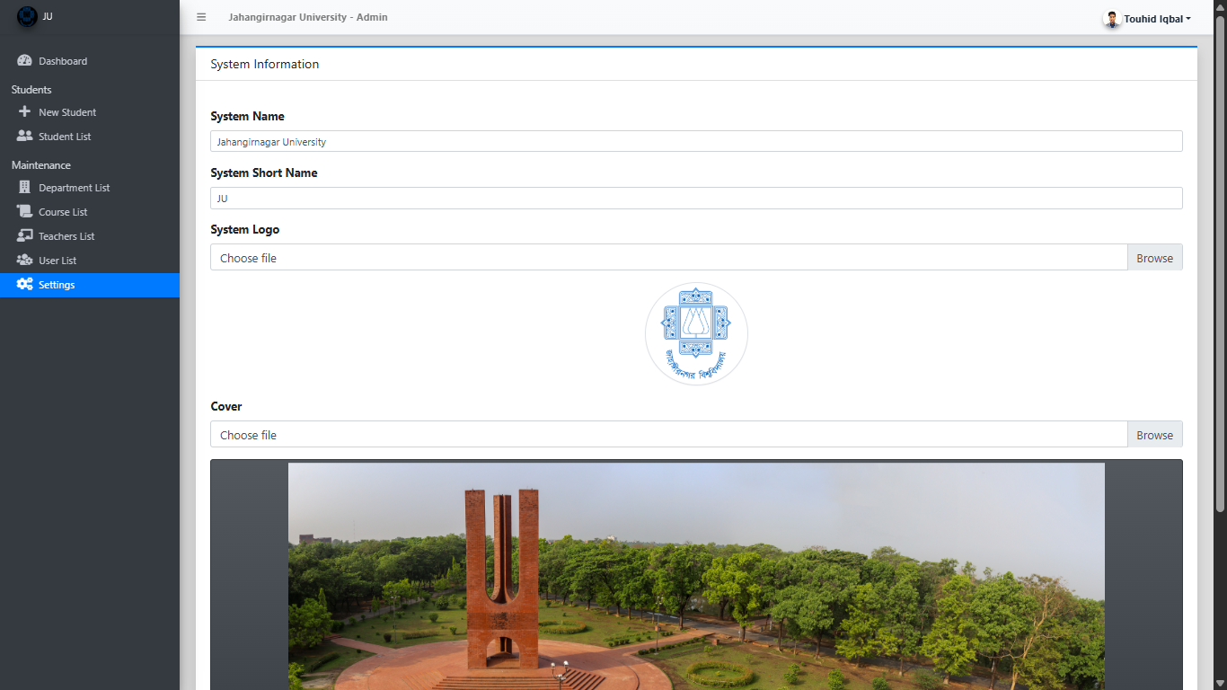
User Interface & Features
Figure: Settings page of Student Information System

Slide 20
Implementation
Development methodology:
Requirement Gathering & Analysis
Planning & System Design
Agile Development Process (Iterative Development)
Testing & Quality Assurance
Deployment & Maintenance
Programming language and framework used:
Programming language: PHP
Backend Development: PHP.
Frontend Development: HTML, CSS.
Frameworks & Libraries: Laravel (PHP), Bootstrap (CSS).
Database: MySQL, SQL Server.
Version control: Git, GitHub

Slide 21
Implementation
Challenge Faced:
Requirement Challenges
Design & Architecture Challenges
Development Challenges
Security and Privacy Concerns
Testing & Quality Assurance Challenges
Performance and Reliability Issues.
User Adoption Challenges

Slide 22
Testing & Debugging
Types of testing conducted:
Functional Testing
Non-Functional Testing
Regression & Maintenance Testing
Database Testing

Slide 23
Testing & Debugging (Test Cases & Results)
Test Case ID | Test Scenario | Expected Result | Status
TC-01 | Login with valid credentials | Dashboard should load successfully | Pass
TC-02 | Login with invalid password | Error: 'Invalid credentials' | Pass
TC-03 | Login with empty fields | Error: 'Fields cannot be empty' | Pass
TC-04 | Password reset functionality | Password successfully updated | Pass
TC-05 | Register new student with valid data | Student record created successfully | Pass
TC-06 | Register student with missing fields | Error: 'All fields are mandatory' | Pass
TC-07 | Enroll in a course | Enrollment successful | Pass
TC-08 | Drop an enrolled course | Course removed from student's list | Pass
TC-09 | Generate student performance report | Report generated successfully | Pass

Slide 24
Deployment & Hosting
This web project is deployed in Local Server.
Hosting Platform: XAMPP
Installation or Setup Process:
Clone the Repository
Install Backend Dependencies
Configure Database
Start Backend Server
Install Frontend Dependencies
Configure Frontend
Start Frontend Server

Slide 25
Results & Findings
Centralized Student Data Management.
Efficient Record Keeping
Grade and Performance Management
User Role Management
Secure and Accessible
Reduced Paperwork

Slide 26
Results & Findings (Comparison with Existing Solutions)
Feature | Student Information System | Existing Solutions
Customization | Can be tailored to specific institutional needs | Often rigid, limited customization
Cost | More cost-effective for small institutions | Expensive licensing & maintenance fees
Ease of Use | Simplified interface | Complex, requires training
Integration | Can integrate with other school systems | Pre-integrated, but costly for extras
Security & Privacy | Custom security based on roles | High security, but less customizable
Report Generation | Tailored reporting | Predefined reports, limited customization
Technical Support | Requires in-house/outsourced support | Professional support, high cost

Slide 27
Future Enhancements
Mobile application support (Android, IOS)
Online fee management.
Timetable management.
Automated Notifications.
Integrated Learning Management System (LMS).
Chat and Discussion Forum.
Attendance Tracking.
Parent and Student Portals.

Slide 28
Conclusion
Project Name: Student Information System (SIS)
Purpose: To provide a digital platform for managing and organizing student-related data, enhancing administrative efficiency, and improving communication between students, teachers, and parents.
Target Users: Students, Teachers, Parents, School Administrators
Key Features: Centralized student data management (personal information, academic records, attendance)
Grade and performance management
User role-based access for teachers and admins

Slide 29
Conclusion
Benefits: Reduces paperwork and manual record-keeping
Improves accuracy and accessibility of student data
Enhances communication and transparency across school systems
Provides a secure and centralized platform for sensitive information
Planned Future Features:
Mobile app support, online fee management, and timetable management
Integrated Learning Management System (LMS) and chat forum
Advanced reporting and analytics

Slide 30
References
A.A. Eludire (August 30, 2015). Design and Implementation of Student Academic Record Management System. Retrieved from Academia: https://www.academia.edu/20105861/The_Design_and_Implementation_of_Student_Academic_Record_Management_System
Abuka V. (May 2019). Design and Implementation of Student Information System. Retrieved from Academia: https://www.academia.edu/41948679/Design_and_Implementation_of_a_Student_Information_System
Alwan, M. (2015, January 9). What is System Development Life Cycle? Retrieved from Airbrake: https://airbrake.io/blog/sdlc/what-is-system-development-life-cycle

Slide 31
References
Didacus, (2018). What Does System Design Mean?. Retrieved from techopedia: https://www.techopedia.com/definition/29998/system-design
Gagliordi, N. (2014, August 21). US universities at greater risk for security breaches than retail and healthcare: BitSight. Retrieved from ZDNet: https://www.zdnet.com/article/us-universities-at-greater-risk-for-security-breaches-than-retail-and-healthcare-bitsight/

Slide 32


